Slide 1

Unravelling the productivity secrets of Visual Studio 2017
Kathleen Dollard
.NET Team, Microsoft
@KathleenDollard
kdollard@microsoft.com

Slide 2
Do you spend most of your day working in Visual Studio? Do you feel that you know all there is to know about it? This session is all about unlocking the hidden features in order to boost your productivity and help you code more efficiently. Visual Studio 2017 comes packed with new functionality, but this is about old and new alike, and you’ll be surprised how many features you don’t use but you should. Join me in this session as I walk you through Visual Studio 2017 and unravel feature after feature to help you become a Visual Studio Jedi master.

Slide 3

My hero

Slide 4
Productivity
Effectiveness with language
Effectiveness with team
Building the right thing
Effectiveness with tools
Building in quality

Slide 5
Effectiveness with language (C#)

Slide 6
Demo!
Refactoring (ThankYouMessage)

Slide 7
Effectiveness with language
public (IEnumerable<string> messages, int staffCount, int)
GetThankYouMessages2(IEnumerable<Person> persons)
{
var messages = new List<string>();
int staffCount = 0;
foreach (Person person in persons)
{
string message = GetThankYouMessage(person);
if (person is Staff staff)
{ staffCount += 1; }
messages.Add(message);
}
return (messages, staffCount, 42);
}

Slide 8
Effectiveness with language
public (IEnumerable<string> messages, int staffCount, int)
GetThankYouMessages(IEnumerable<Person> persons) =>
(
persons.Select(x => GetThankYouMessage(x)),
persons.Where(x => x is Staff).Count(),
42
);

Slide 9
Effectiveness with language
public (IEnumerable<string> messages, int staffCount, int)
GetThankYouMessages2(IEnumerable<Person> persons)
{
var messages = new List<string>();
int staffCount = 0;
foreach (Person person in persons)
{
string message = GetThankYouMessage(person);
if (person is Staff staff)
{ staffCount += 1; }
messages.Add(message);
}
return (messages, staffCount, 42);
}
public (IEnumerable<string> messages, int staffCount, int)
GetThankYouMessages(IEnumerable<Person> persons) =>
(
persons.Select(x => GetThankYouMessage(x)),
persons.Where(x => x is Staff).Count(),
42
);

Slide 10
Effectiveness with language
public (IEnumerable<string> messages, int staffCount, int)
GetThankYouMessages2(IEnumerable<Person> persons)
{
var messages = new List<string>();
int staffCount = 0;
foreach (Person person in persons)
{
string message = GetThankYouMessage(person);
if (person is Staff staff)
{ staffCount += 1; }
messages.Add(message);
}
return (messages, staffCount, 42);
}
public (IEnumerable<string> messages, int staffCount, int)
GetThankYouMessages(IEnumerable<Person> persons) =>
(
persons.Select(x => GetThankYouMessage(x)),
persons.Where(x => x is Staff).Count(),
42
);

Slide 11
Effectiveness with language
public (IEnumerable<string> messages, int staffCount, int)
GetThankYouMessages(IEnumerable<Person> persons) =>
(
persons.Select(x => GetThankYouMessage(x)),
persons.Where(x => x is Staff).Count(),
42
);

Slide 12
Effectiveness with language
public (IEnumerable<string> messages, int staffCount, int)
GetThankYouMessages(IEnumerable<Person> persons) =>
(
persons.Select(x => GetThankYouMessage(x)),
persons.Where(x => x is Staff).Count(),
42
);

Slide 13
Effectiveness with language
public (IEnumerable<string> messages, int staffCount, int)
GetThankYouMessages2(IEnumerable<Person> persons)
{
var messages = new List<string>();
int staffCount = 0;
foreach (Person person in persons)
{
string message = GetThankYouMessage(person);
if (person is Staff staff)
{ staffCount += 1; }
messages.Add(message);
}
return (messages, staffCount, 42);
}
public (IEnumerable<string> messages, int staffCount, int)
GetThankYouMessages(IEnumerable<Person> persons) =>
(
persons.Select(x => GetThankYouMessage(x)),
persons.Where(x => x is Staff).Count(),
42
);
C# is working hard to increase the simplicity of the code you look at
Use new features

Slide 14
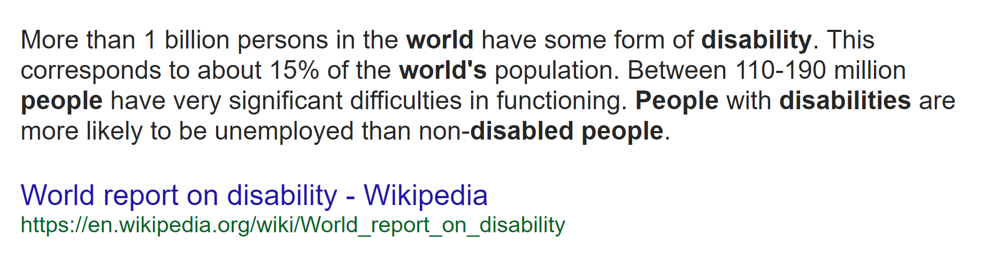
A focus on accessibility…
New in 15.3, we made over 1,700 targeted fixes to improve compatibility between Visual Studio and the assistive technologies that many customers use.
Visual Studio becomes more accessible

Slide 15
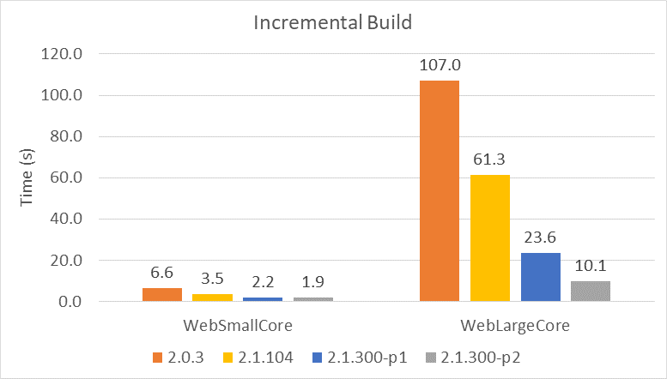

Slide 16
Effectiveness with team

Slide 17
You
Your Team
Your Company
Your Clients and Your Community

Slide 18
You
Your Team
Your Company
Your Community

Slide 19
What did I have for lunch last Thursday?

Slide 20
I don’t know
The Three Hardest Words in the English Language
freakonomics.com
http://tinyurl.com/kad-idontknow

Slide 21

Until you can admit what you don’t know,
it’s virtually impossible to learn what you need to.
Because if you think you already have all the answers,
you won’t go looking for them.
The way you learn
is from feedback.

Slide 22
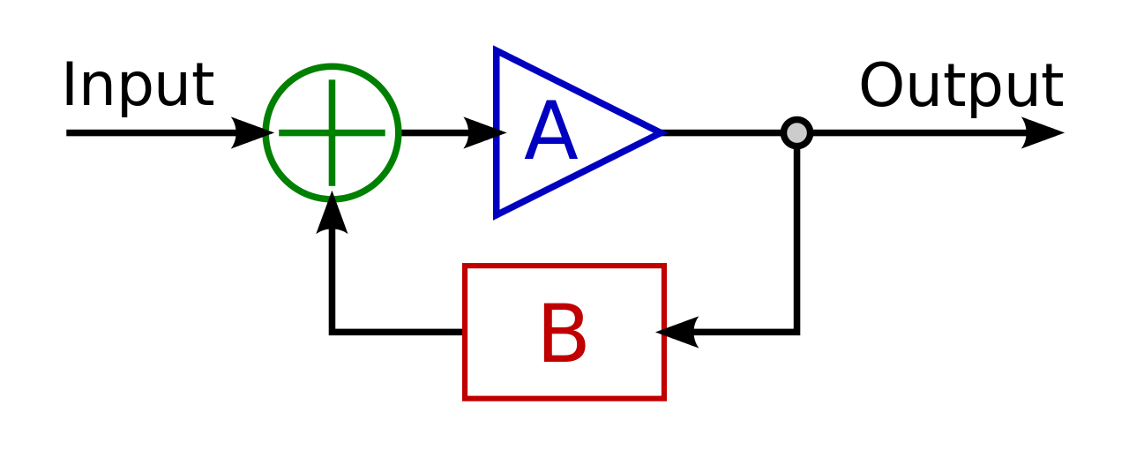

Slide 23

We developers should probably be pretty good at this feedback thing

Slide 24


Slide 25
The more you know, the more you know you don’t know
Attributed to: Socrates
Aristotle
Albert Einstein

Slide 26


Slide 27

When you were a baby you tried to walk and fell down every time.
http://startupbros.com/21-ways-overcome-impostor-syndrome/

Slide 28

When you were a baby you tried to walk and fell down every time.
Were you a walking impostor?
Who are you to walk!?
http://startupbros.com/21-ways-overcome-impostor-syndrome/

Slide 29

When you were a baby you tried to walk and fell down every time.
Were you a walking impostor?
Who are you to walk!?
You can’t even do it! It’s absurd!
http://startupbros.com/21-ways-overcome-impostor-syndrome/

Slide 30

I don’t even have impostor syndrome.
That’s how bad my impostor syndrome is.
[following a series of quotes from women on imposter syndrome]
Apparently this is mostly a problem for women.
I don’t buy that though.
I think that guys just won’t talk about it.
You are growing into something different.
You are getting better.
How?
By trying to do something better than you actually can.
That’s not a lie, that’s valor.
http://startupbros.com/21-ways-overcome-impostor-syndrome/

Slide 31
I don’t even have impostor syndrome.
That’s how bad my impostor syndrome is.
You are growing into something different.
You are getting better.
How?
By trying to do something better than you actually can.
That’s not a lie, that’s valor.
http://startupbros.com/21-ways-overcome-impostor-syndrome/

Slide 32
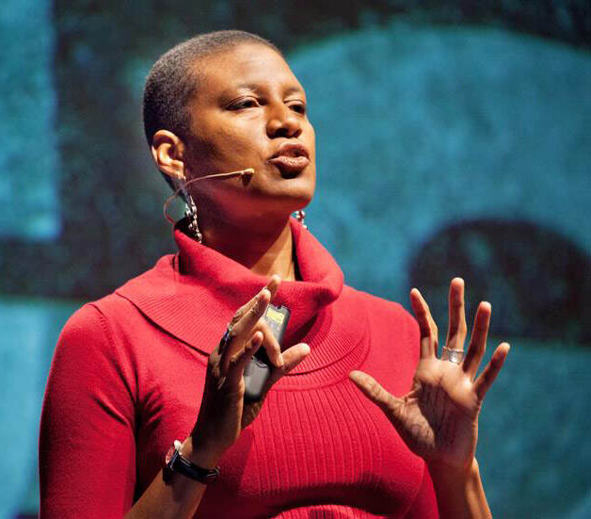
Banish Your Inner Critic – Coming in 2017 by Denise Jacobs
Identify and quiet the insidious voice in your head of your Inner Critic
Conquer Imposter Syndrome
Disarm the evil twins of perfectionism and procrastination
Free yourself from comparisons, overwhelm, and self-sabotage
www.DeniseJacobs.com

Slide 33


Slide 34
Too much confidence
You aren’t learning
You’re a jerk
Blocking other people’s full selves
Imposter Syndrome
You aren’t learning
Not contributing your full self

Slide 35





Slide 36
Empathy is difficult
If you believed what he believes,
you'd do precisely what he's doing.
Think about that for a second.
People act based on the way they see the world.
Every single time.
Understanding someone else's story is hard,
a job that's never complete,
but it's worth the effort.
http://sethgodin.typepad.com/seths_blog/2016/07/empathy-is-difficult.html

Slide 37
Empathy is difficult
If you believed what he believes,
you'd do precisely what he's doing.
Think about that for a second.
People act based on the way they see the world.
Every single time.
Understanding someone else's story is hard,
a job that's never complete,
but it's worth the effort.
Assume everyone around you is sincerely trying to do the best thing
http://sethgodin.typepad.com/seths_blog/2016/07/empathy-is-difficult.html

Slide 38
None of us are as smart as all of us

Slide 39
Building the right thing

Slide 40
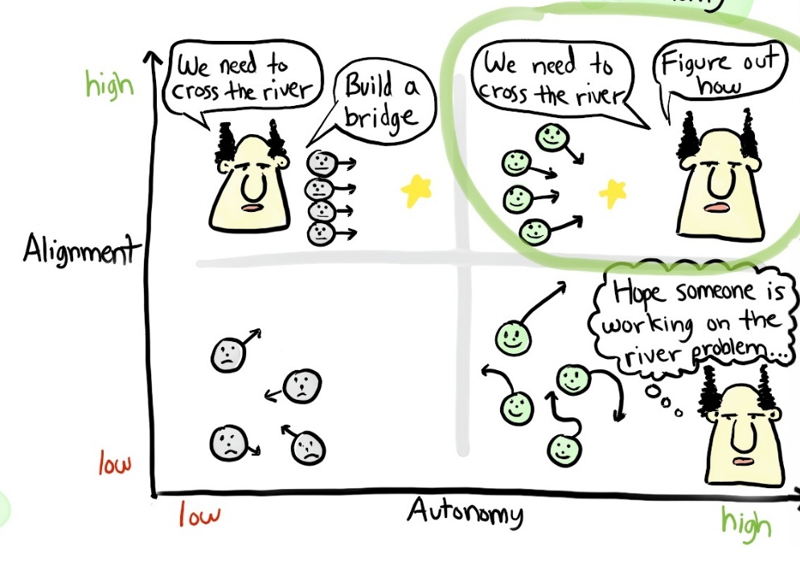
Strive for the right goals

Slide 41


Slide 42

How did NASA come back from the moon?

Slide 43
Listen, Test, Design, Test, Prototype, Test,

Slide 44
Listening is hard

Slide 45
Effectiveness with tools

Slide 46
Refactoring
Creating – typing and style
Viewing code
Navigation
Search
Errors and Exceptions
Debugging

Slide 47
Typing and creating code (Program.cs)
Keyboard options
Add separators
Default naming (spell of CancellationToken)
Selecting code
Ctl-Shift arrow
Column editing
Changing case
Clipboard ring

Slide 48
IntelliSense
Filtering
Pascal matching

Slide 49
Code style
Embrace your bad habits!
And let the editor fix it
Tools/Options/Text Editor/C#/Code Style
Alt-Q Style
Your preferences, can roam and save
.editorconfig
For your project, check it in!
Reference: https://aka.ms/editorconfigref

Slide 50
Viewing code
Font size
Outlining
Multiple windows

Slide 51
Navigation: Definition and Implementation
Go to definition: F12
Go to implementation: Ctl F12
Go to definition: Ctl Click
Go to all: Ctl T or Ctl ,
Find all references
Structure visualizer lines – hover
New Exception dialog
Navigate from all dialogs
Sync with Solution Explorer
Go To Brace Ctl-]
Add Shift to most for selection

Slide 52
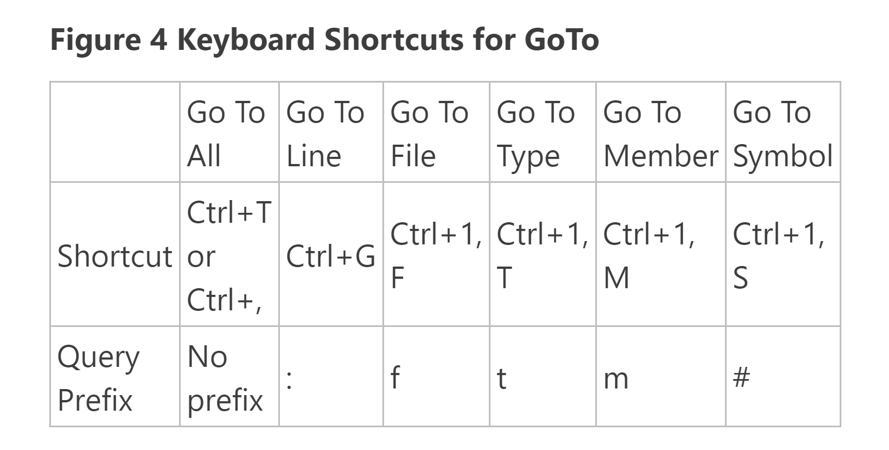

Slide 53
Search
Search in all dialogs
BigSearch and little search
Custom ToDo items
RegEx

Slide 54
Errors
Filters
Add category
Filter glyph
Window arrangement

Slide 55
Debugging
Break and tracepoints
Undo
Auto and Locals
Multiple Watch
Exceptions

Slide 56
New Refactorings
Add parameter (from CallSite)
Generate overrides
Add named argument
Add null-check for parameters
Insert digit-separators into literals
Change base for numeric literals (for example, hex to binary)
Convert if-to-switch
Remove unused variable

Slide 57
Two new tricks a week
Let yourself forget the ones that don’t matter

Slide 58
Building in quality

Slide 59
Quality, Cost, Time: ‘pick any two’
You can’t increase productivity by decreasing quality
Low quality software has high cost and schedule issues
DURING DEVELOPMENT PHASE

Slide 60
Avoid bad use of async
(An exercise if we have too much time)

Slide 61
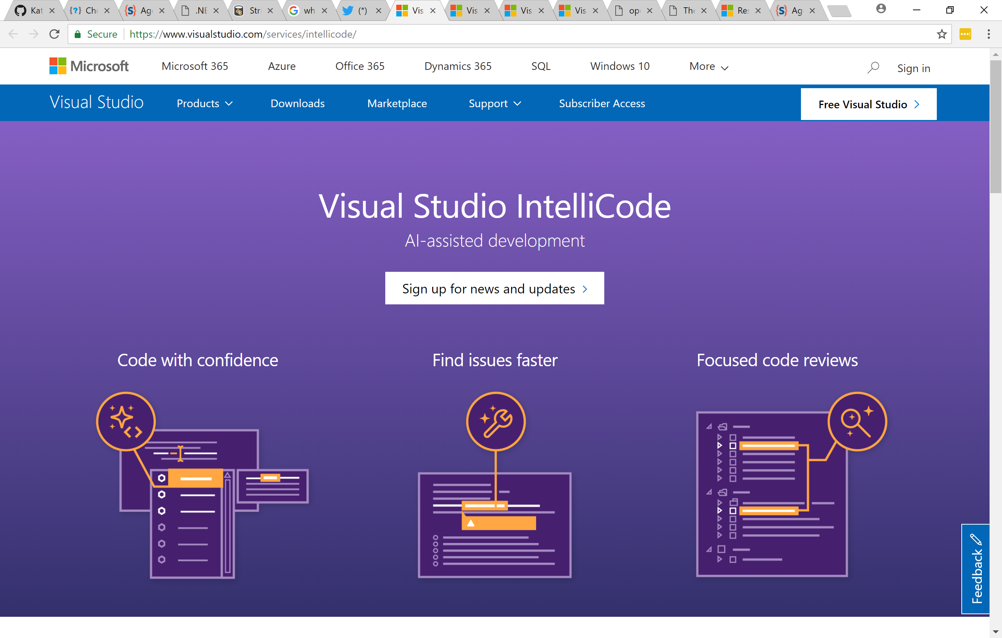
Cool things I didn’t show
Live share
IntelliCode

Slide 62
Productivity
Effectiveness with language
Effectiveness with tools
Effectiveness with team
Building the right thing
Building in quality

Slide 63
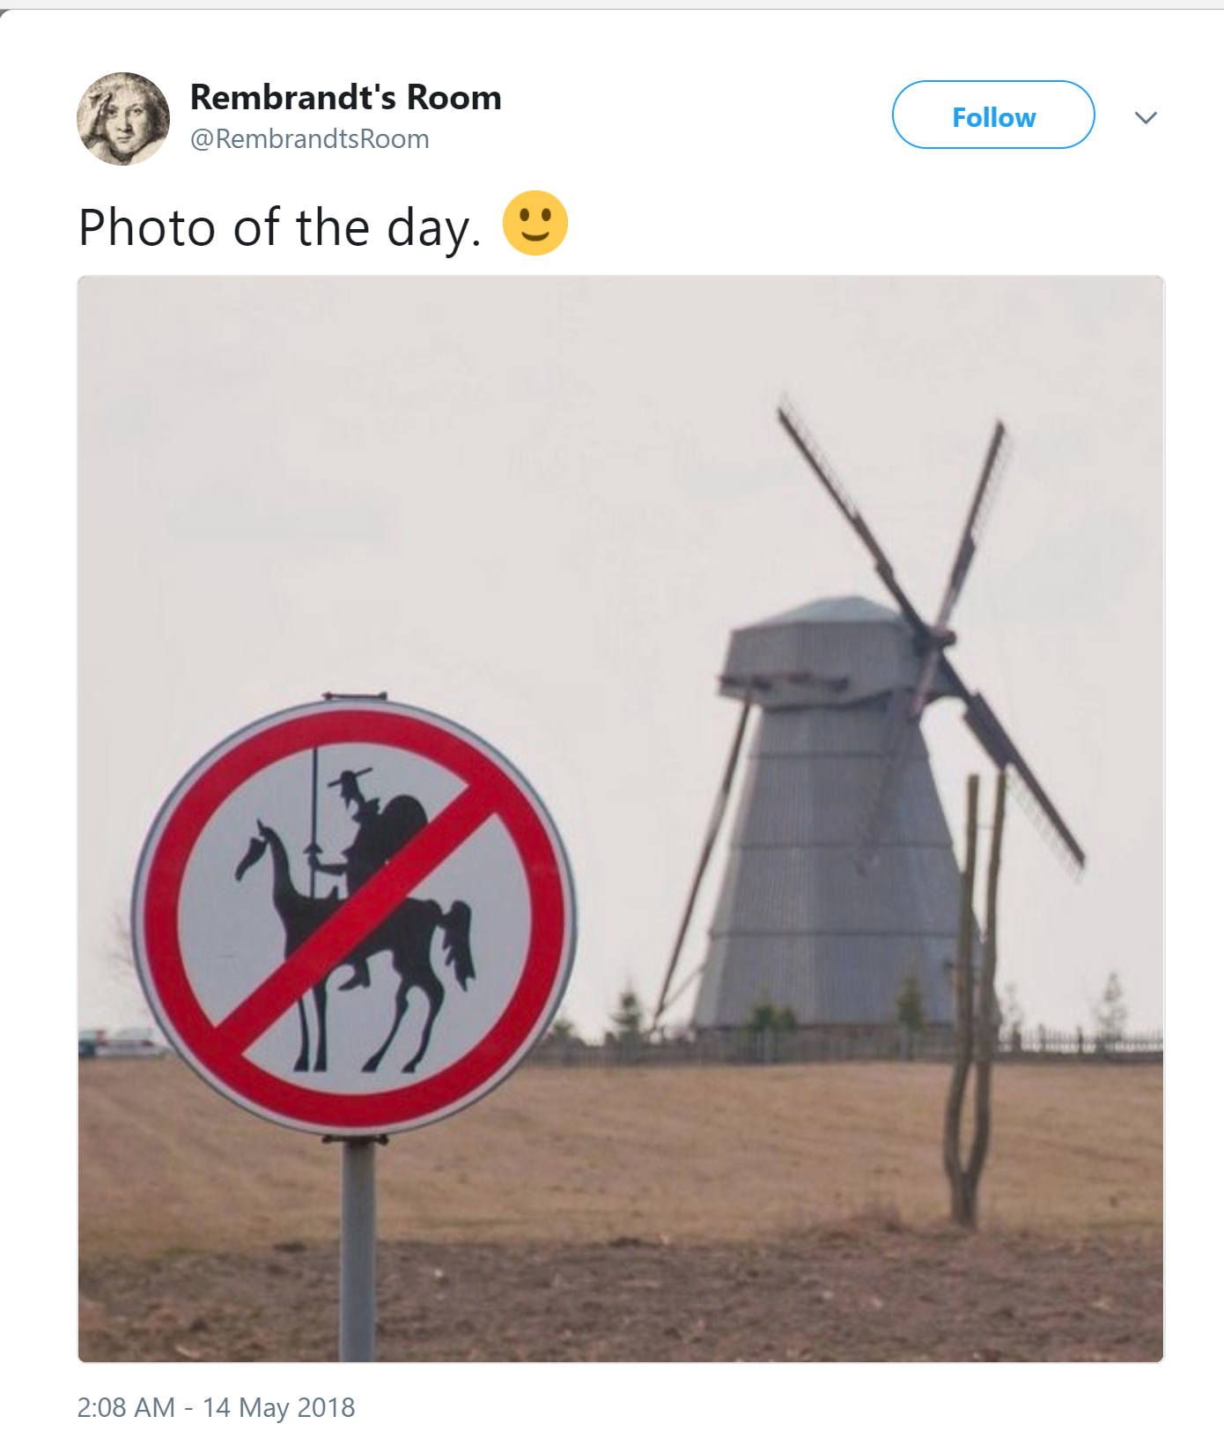
Questions? @kathleendollard kdollard@microsoft.com

